Slide 1

Ticket Booking System
System Analysis, Architecture, and Design

Slide 2
Team Intro
Group 10 Jatin Chopra, Anisha Agarwal, Prathik Kumar Gaddam

Slide 3
Problem Outline
To present the UML models for the Ticket Booking System.
To illustrate system design from requirements to implementation.
To ensure clarity in functional and structural aspects.

Slide 4
Project Vision- Ticket booking system
Seamless Mobile Experience – Develop a user-friendly mobile application for Flight Ticket Booking using Java, allowing users to search flights, select seats, and complete bookings effortlessly.
Secure Transactions and Notifications – Implement robust payment processing and timely notifications to enhance user trust and system reliability.
Enhanced User Trust – Integrate secure payment gateways and timely notifications to build credibility and system reliability.
Smart Ticket Management – Enable efficient ticket tracking.

Slide 5
Agenda
System Requirements (Use Case & Activity Diagrams)
Analysis Model (Robustness Diagram)
Architecture Model (Package & Component Diagrams)
Design Model (Class, Sequence, and State Diagrams)

Slide 6
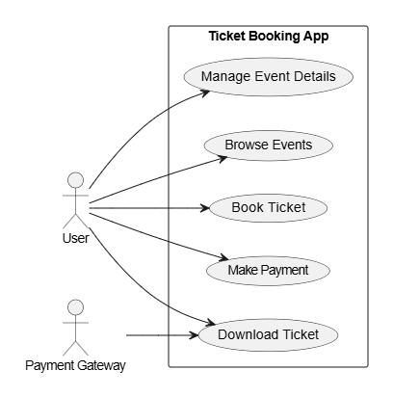
Use Case Diagram

Slide 7
Use Case Diagram
Purpose:
Defines user interactions with the system.
Identifies key actors and use cases.
Key Actors:
User → Searches flights, books tickets, and make payments.
Payment System → Processes transactions.
Notification System → Sends booking confirmations.

Slide 8
Key Use Cases
Search Flights
Select Flight & Seat
Book Ticket
Make Payment

Slide 9
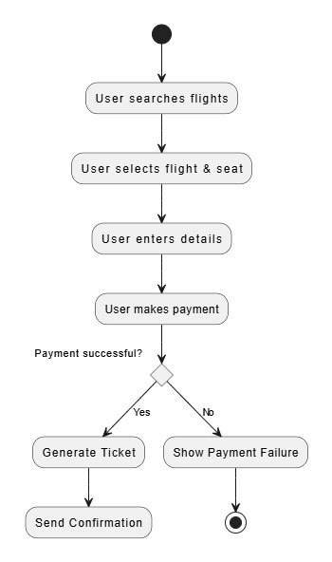
Activity Diagram - Booking Process

Slide 10
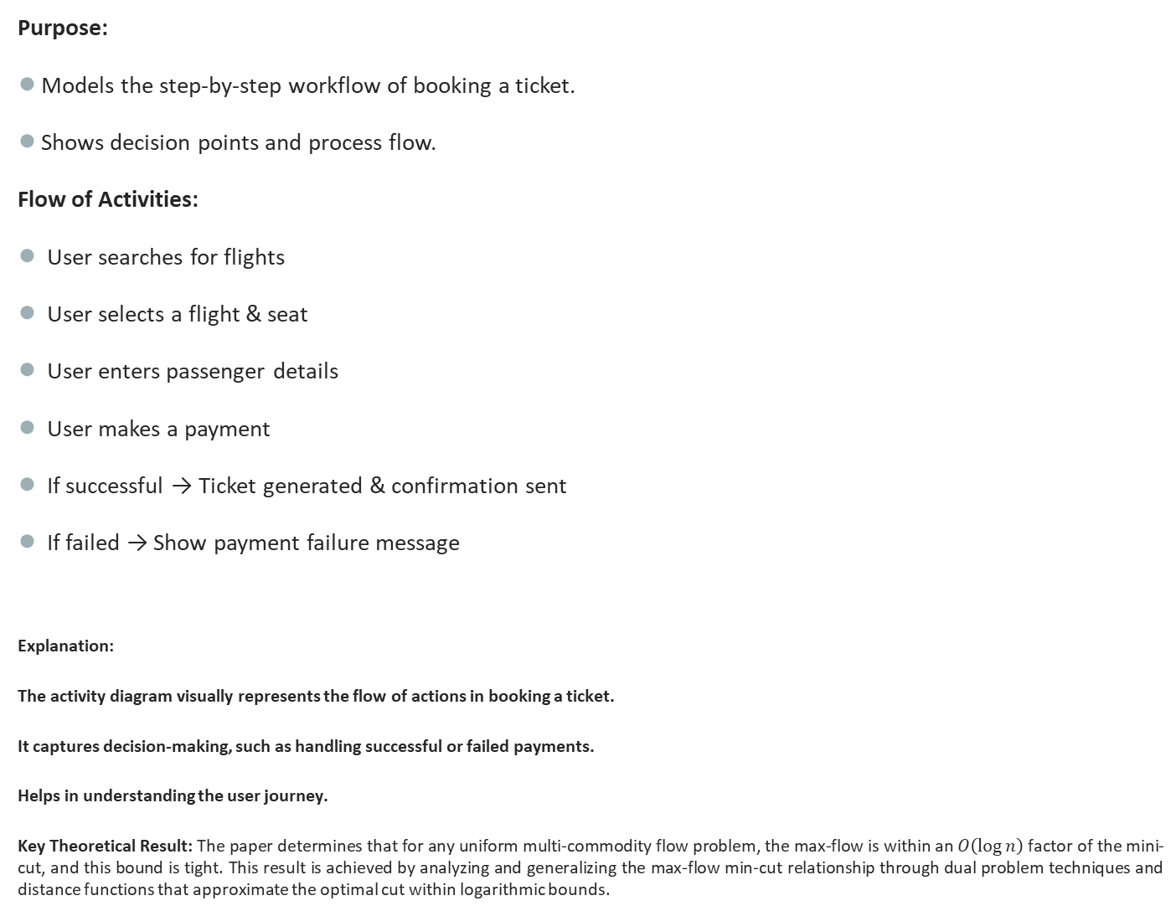
Activity Diagram - Booking Process
Purpose:
Models the step-by-step workflow of booking a ticket.
Shows decision points and process flow.
Flow of Activities:
User searches for flights
User selects a flight & seat
User enters passenger details
User makes a payment
If successful → Ticket generated & confirmation sent
If failed → Show payment failure message
Explanation:
The activity diagram visually represents the flow of actions in booking a ticket.
It captures decision-making, such as handling successful or failed payments.
Helps in understanding the user journey.
Key Theoretical Result: The paper determines that for any uniform multi-commodity flow problem, the max-flow is within an $O\left(\log{n}\right)$ factor of the mini-cut, and this bound is tight. This result is achieved by analyzing and generalizing the max-flow min-cut relationship through dual problem techniques and distance functions that approximate the optimal cut within logarithmic bounds.

Slide 11
Explanation
The activity diagram visually represents the flow of actions in booking a ticket.
It captures decision-making, such as handling successful or failed payments.
Helps in understanding the user journey.

Slide 12
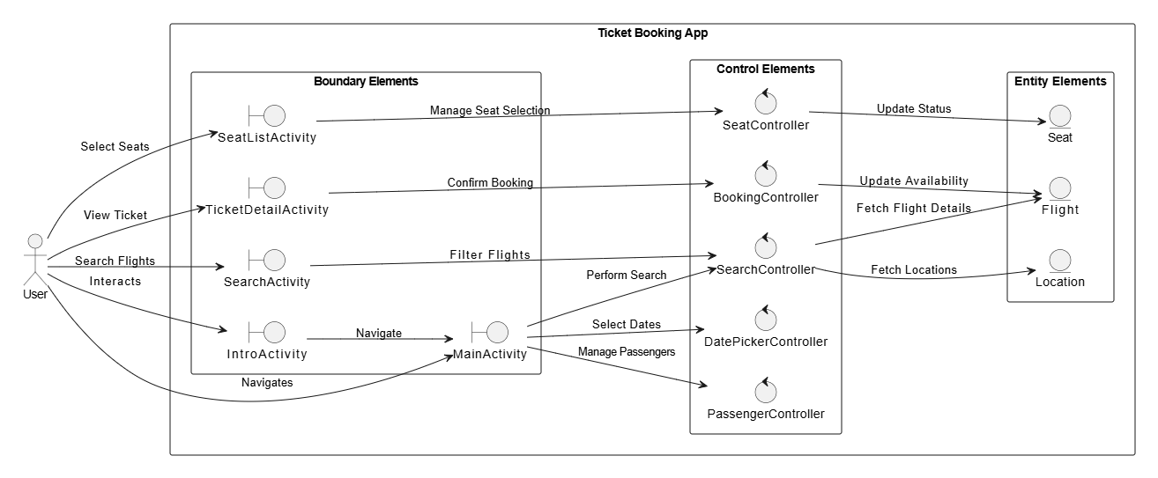
Robustness Diagram

Slide 13
Robustness Diagram
Purpose:
Bridges Use Cases and Design Models.
Identifies Boundary, Control, and Entity classes.
Key Components:
Boundary (Interface): User Interface (UI)
Control: Booking Controller (Handles logic & processing)
Entities: Flight, Ticket, Payment (Core database objects)

Slide 14
Robustness Diagram
Explanation:
Boundary classes define system interfaces (GUI, APIs).
Control classes handle business logic (e.g., processing a booking).
Entity classes represent real-world objects stored in the database.

Slide 15
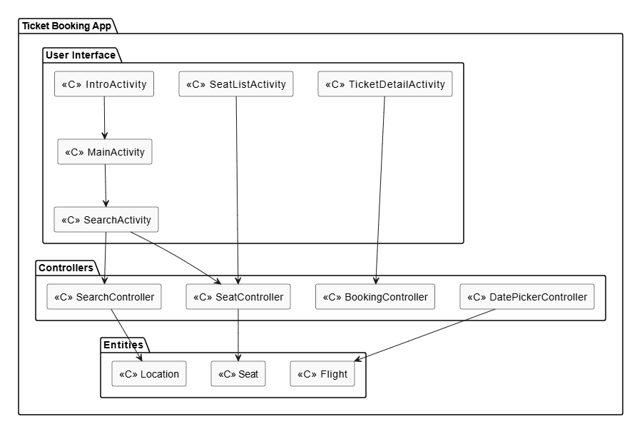
Package Diagram

Slide 16
Package Diagram
Purpose:
Organizes the system into logical groups.
Helps in modularization and code maintainability.
Main Packages:
Interface Package → Handles user interactions.
Control Package → Manages booking & payments.
Entity Package → Represents core database objects.
Relationships:
UserGUI → BookingController (Initiates booking process).
BookingController → Flight, Ticket, Payment.

Slide 17
Package Diagram
Explanation:
A package diagram helps structure the system efficiently.
Dividing the system into packages ensures better maintainability & scalability.

Slide 18
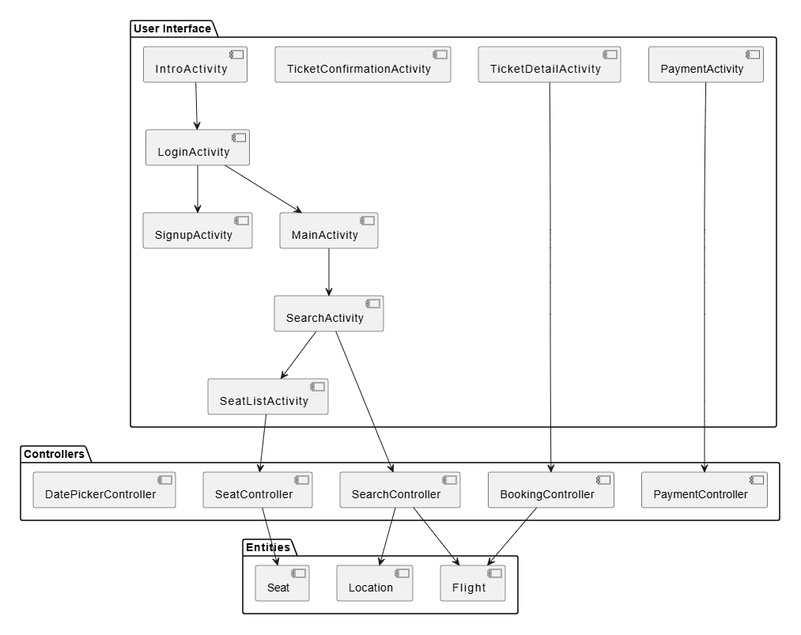
Component Diagram

Slide 19
Component Diagram
Purpose:
Shows system components and their interactions.
Represents services and external dependencies.
Main Components:
User Interface → Handles interactions.
Booking Service → Manages ticket booking.
Payment Service → Processes transactions.
Notification Service → Sends booking confirmations.

Slide 20
Component Diagram
Interactions:
User Interface → Booking Service
Booking Service → Payment Service, Notification Service
Explanation:
This diagram visualizes different system components and their dependencies.
It highlights which components are responsible for which task.

Slide 21
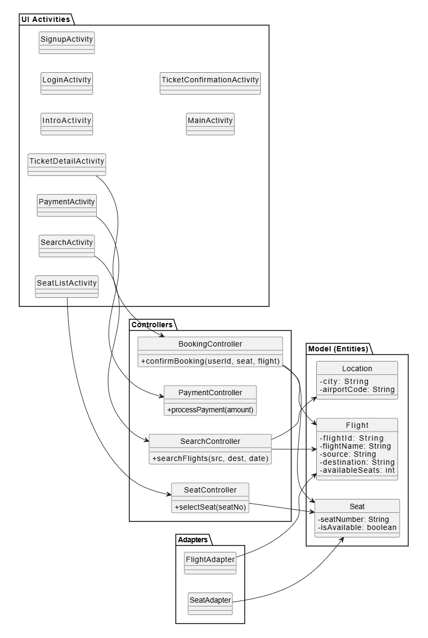
Class Diagram

Slide 22
Class Diagram
Purpose:
Represents system classes, attributes, and methods.
Shows relationships among objects.
Key Classes:
User: userId, name, email
Flight: flightId, source, destination
Ticket: ticketId, seatNumber, booking status
Booking: bookingId, userId, ticket
Relationships:
User → Booking (1-to-Many)
Booking → Ticket (1-to-1)

Slide 23
Sequence Diagram (5 use cases)
Actors & Components:
Actor: User/System Component.
Interface: GUI/API Calls.
Control: Booking/Payment Controller.
Entities: Flight, Ticket, Payment.
Use Cases Covered:
Search Flights
Select Flight & Seat
Book Ticket
Make Payment

Slide 24
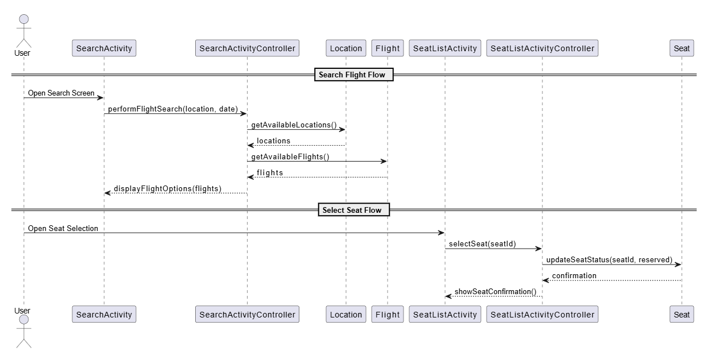
Sequence Diagram (Use case 1: Search Flight)

Slide 25
DEPLOYMENT Diagram
Purpose: To model the physical architecture of a system and show how software components (artifacts) are deployed on the hardware infrastructure (nodes) of the system.
Nodes:
Client Device: Browser or Mobile App
Web Server: Hosts GUI and Controllers
Application Server: Hosts Business Logic
Database Server: Stores persistent data
Key Point:
Scalable architecture separating UI, logic, and data layers for better maintainability.

Slide 26
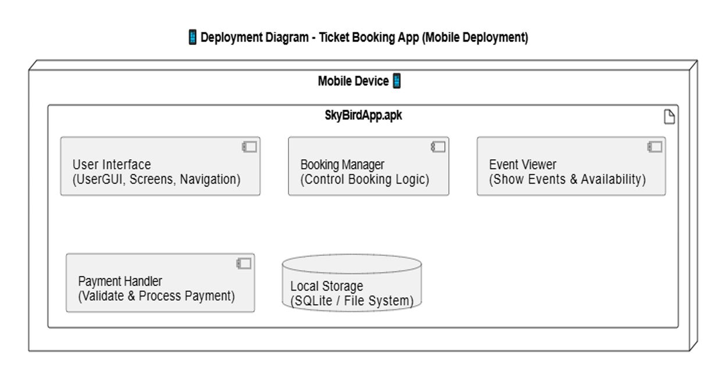
DEPLOYMENT Diagram

Slide 27
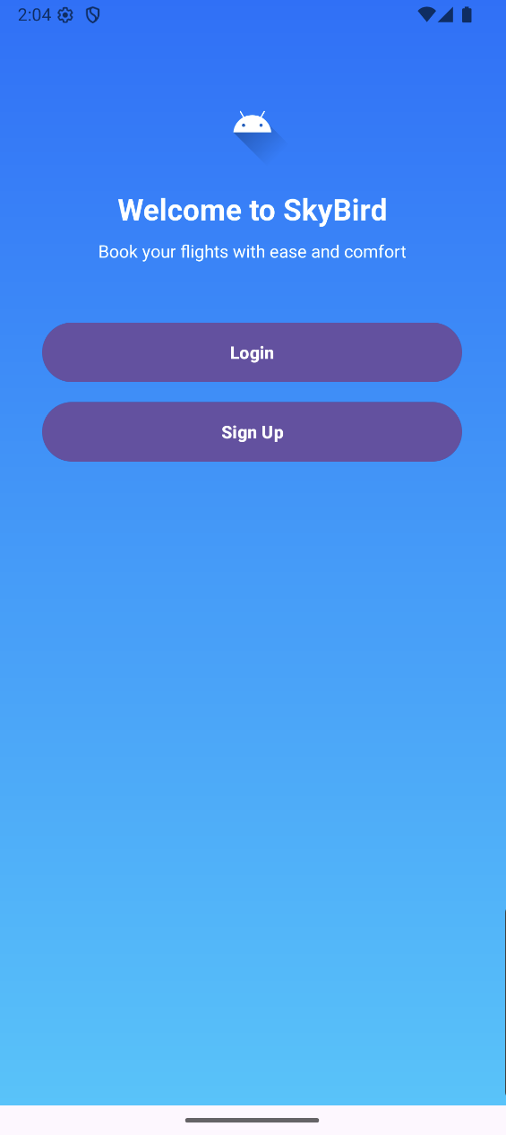
DEMO (App Screenshots)

Slide 28
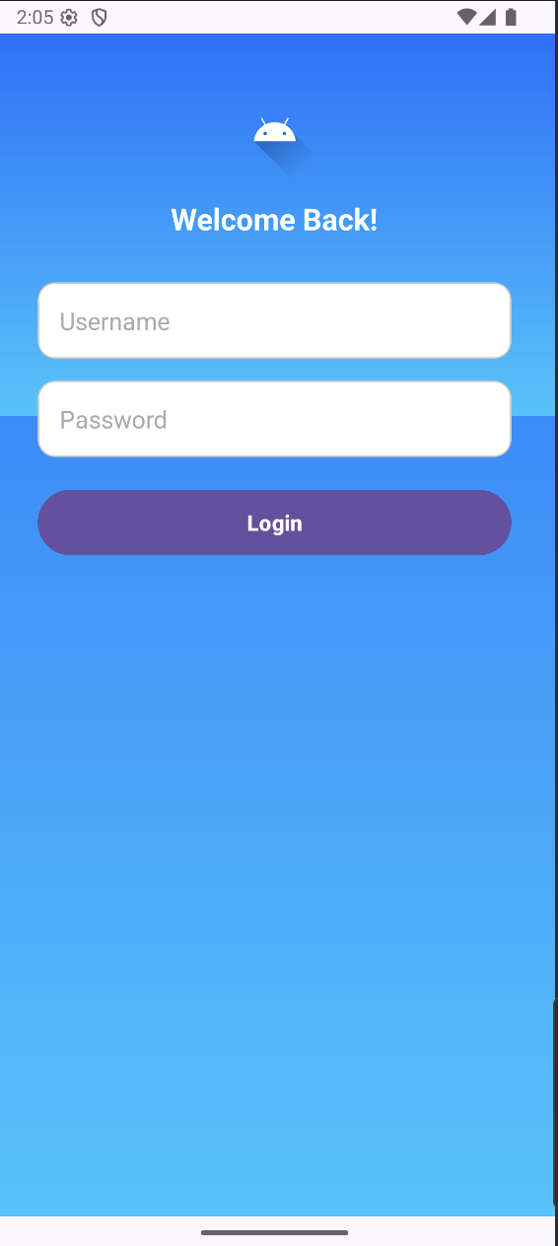
DEMO

Slide 29
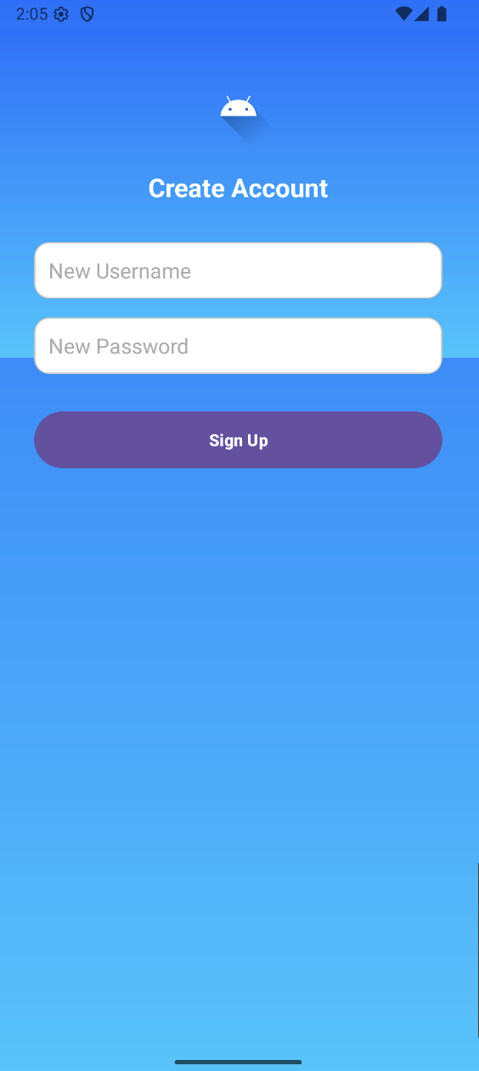
DEMO

Slide 30
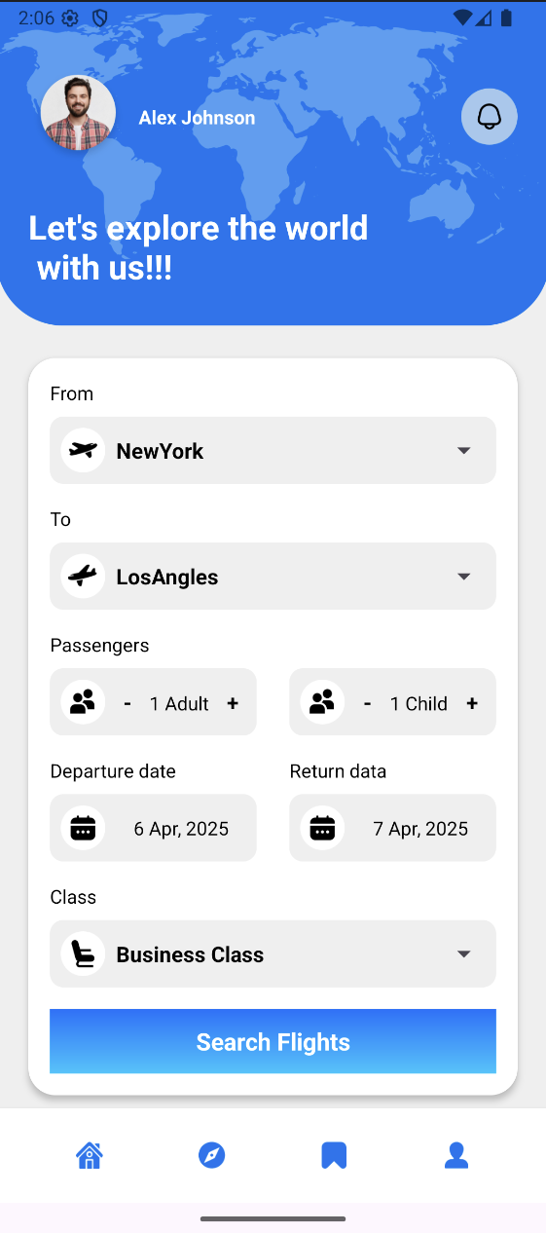
DEMO

Slide 31
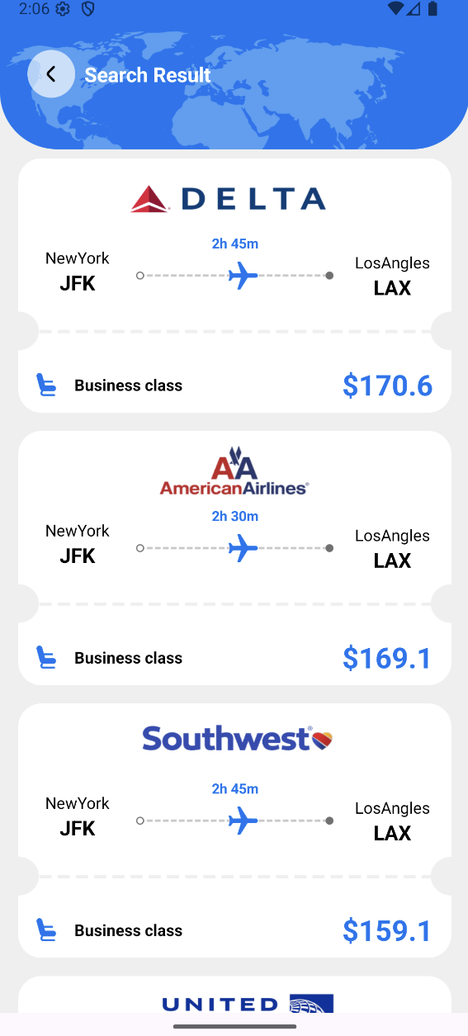
DEMO

Slide 32
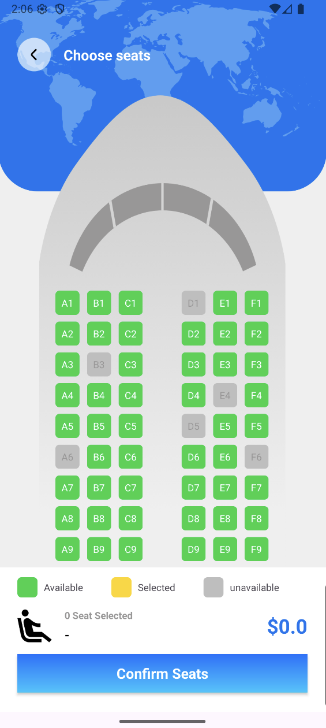
DEMO

Slide 33
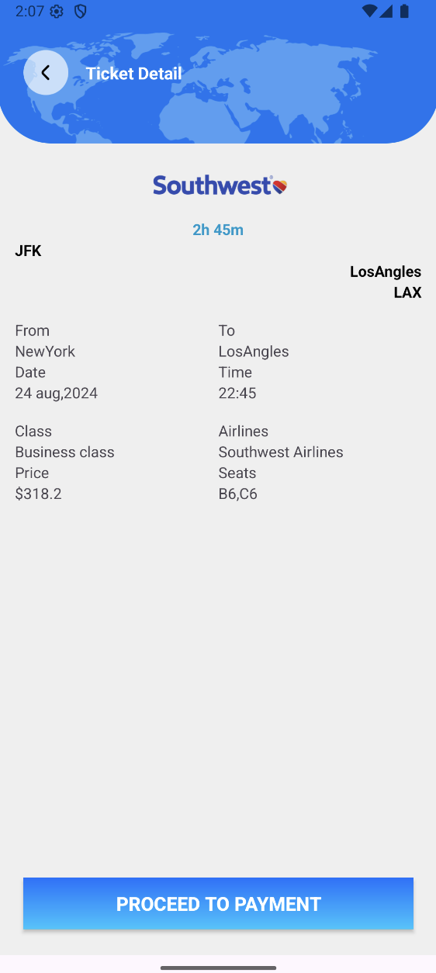
DEMO

Slide 34
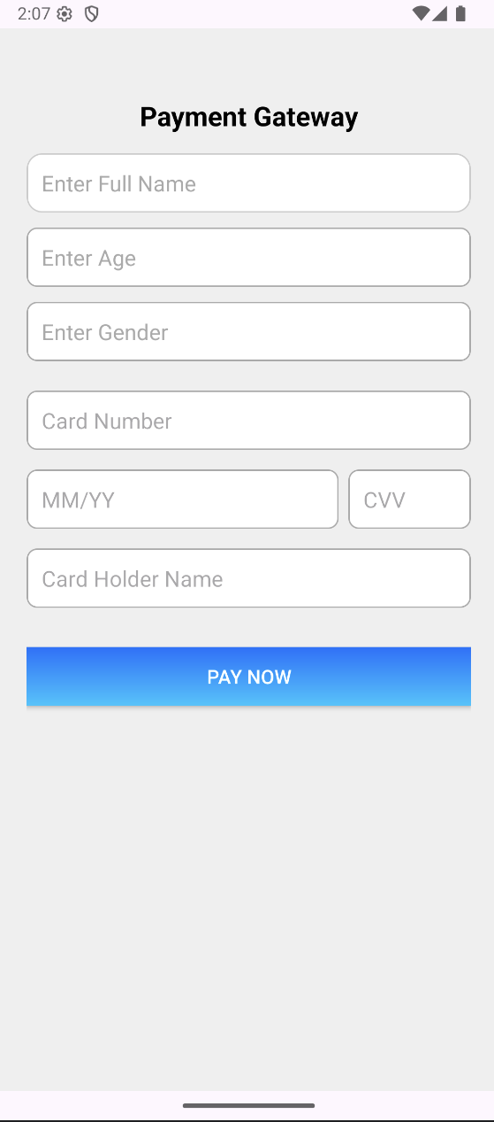
DEMO

Slide 35
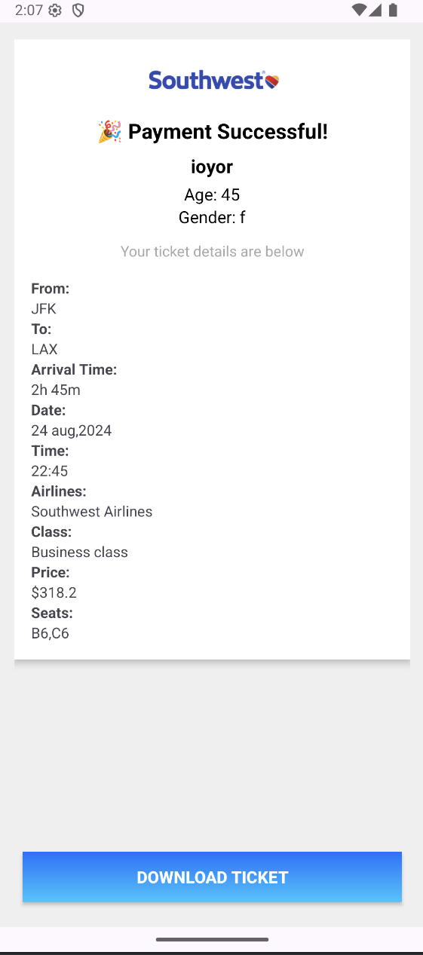
DEMO

Slide 36
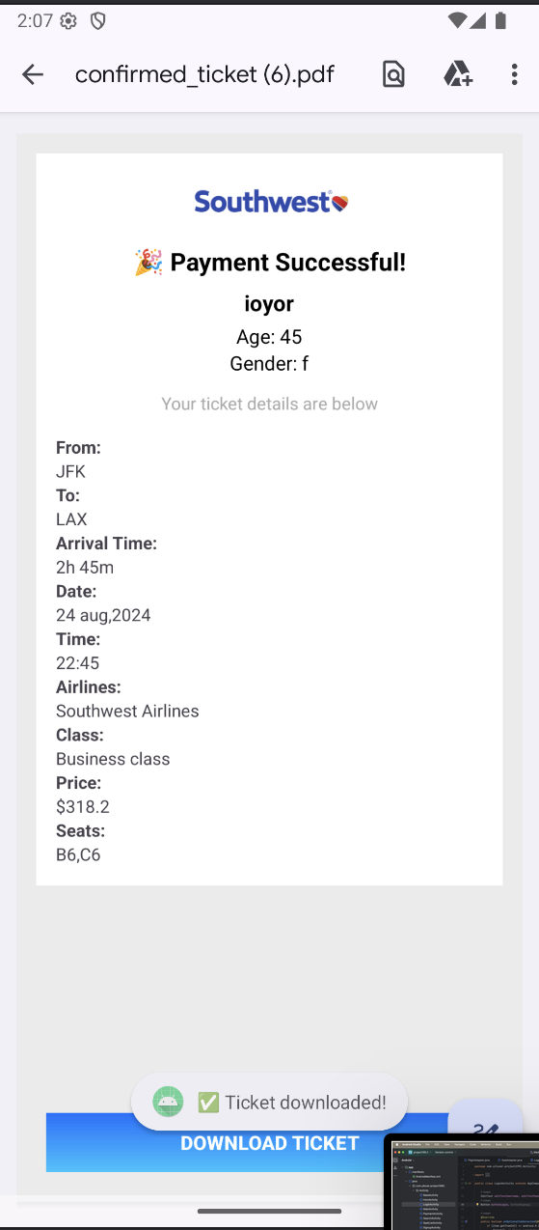
DEMO

Slide 37
Conclusion
This project detailed the complete object-oriented design of a Flight Ticket Booking System, incorporating comprehensive UML diagrams. From requirement analysis to system design, we used Use Case, Activity, Class, Sequence, and Component diagrams to model user interactions, data flow, and logic. The Deployment Diagram provided a clear view of the physical architecture and how system components are hosted and interact in a real-world environment. Together, these models establish a strong foundation for scalable and reliable system implementation.

